Slide 1
Web Development 1
Lab 1
https://www.w3schools.com/html/default.asp

Slide 2
Knowledge
Describe the use of the title and meta elements in the head section of an HTML document.
Describe the use of these block elements: h1, h2, h3, and p.
Describe the use of these inline elements: br, i, b, sup, em, q, and strong.
Distinguish between the use of the <a> element and the img element
Describe the use of these HTML5 semantic elements: header, main, section, article, nav, aside, footer, and figure.

Slide 3
Definitions/Course Content
HTML: HyperText Markup Language (HTML) is the main language for creating web pages and other information that can be displayed in a web browser.
HTML5: Newest revision of HTML, contains many more tags/functionality
XHTML: Extensible HyperText Markup Language.
This is a stricter form of HTML

Slide 4
A generic web folder structure
All your web pages

Slide 5
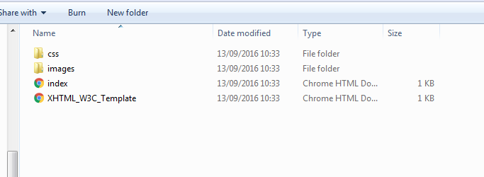
Sample root folder
There must always be an index file
Folders are created for the different file types, images, css, javascript, downloads, etc.

Slide 6
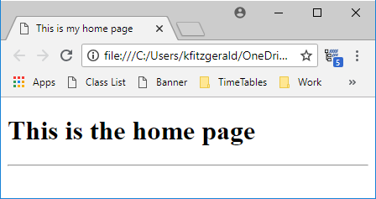
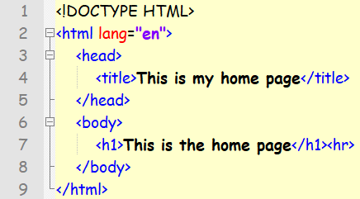
Example 1
The DOCTYPE declaration defines the document type
The text between <html> and </html> describes the web page
The text between <body> and </body> is the visible page content
The text between <h1> and </h1> is displayed as a heading
The text between <p> and </p> is displayed as a paragraph

Slide 7
HTML Tags
HTML markup tags are usually called HTML tags
HTML tags are keywords (tag names) surrounded by angle brackets like <html>
HTML tags normally come in pairs like <b> and </b>
The first tag in a pair is the start tag, the second tag is the end tag
The end tag is written like the start tag, with a forward slash before the tag name
Start and end tags are also called opening tags and closing tags
E.g. <tagname>content</tagname>

Slide 8
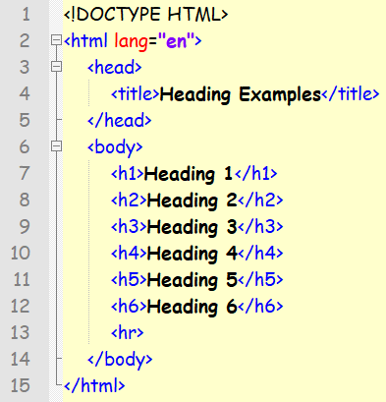
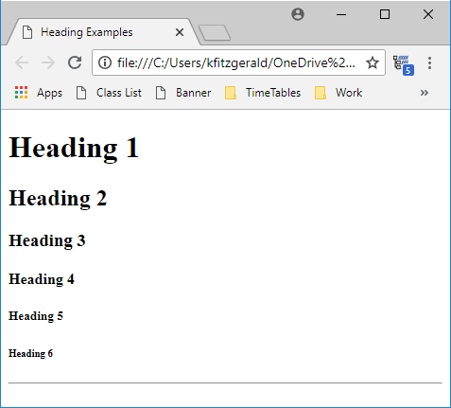
HTML Headings

Slide 9
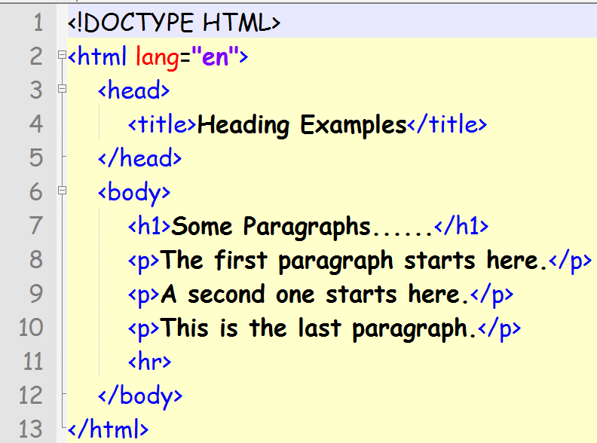
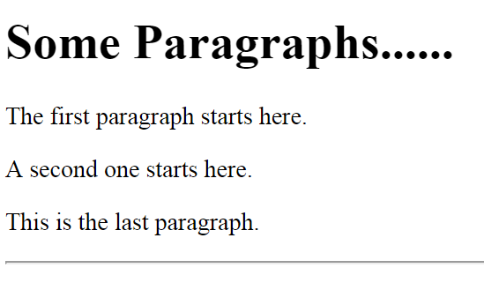
HTML Paragraphs
Paragraphs in HTML are defined with the <p> tag.

Slide 10
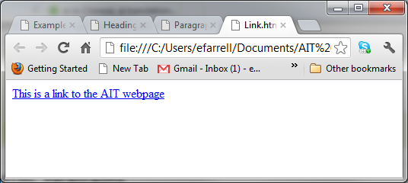
HTML Links
Links in HTML are defined with the <a> tag
<a href="http://www.ait.ie">This is a link to the AIT webpage</a>
href is known as an attribute.

Slide 11
HTML Images
Images in HTML are defined with the <img> tag.
<img src=“ait-icon.png" width=“200" height=“200”>
The src attribute is used to specify the name of the file
The width and height attributes define the size of the image.

Slide 12
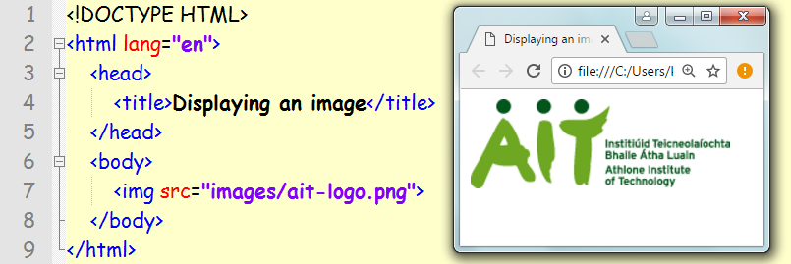
HTML Images
The file ait-logo.png is stored in a folder called images at the same directory level as the html files

Slide 13
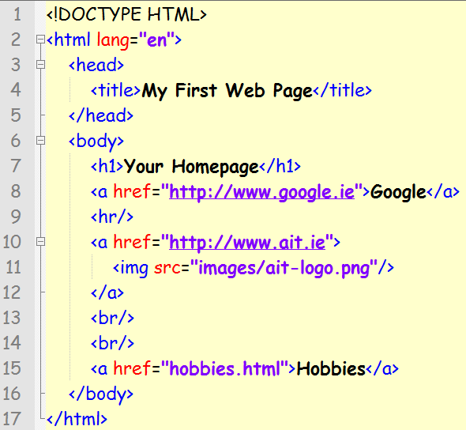
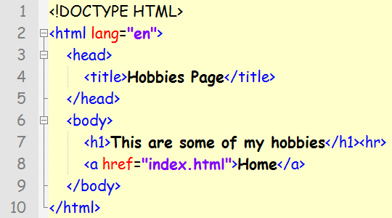
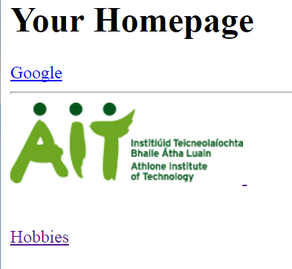
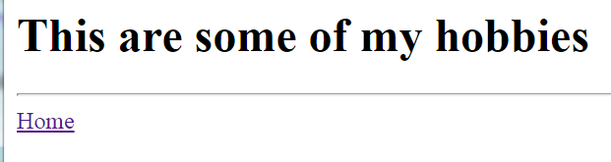

Slide 14
HTML Attributes
HTML elements can have attributes
Attributes provide additional information about an element
Attributes are always specified in the start tag
Attributes come in name/value pairs like: name=“value”
<a href="http://www.ait.ie">This is a link to the AIT webpage</a>

Slide 15
HTML Comments
Comments are used to make code more readable. They are ignored by the browser
<!-- This is a comment -->

Slide 16
HTML Elements
An HTML element starts with a start tag
An HTML element ends with an end tag
The element content is everything between the start and the end tag
Most HTML elements can have attributes
Start Tag | Element Content | End Tag
<h1> | This is a heading | </h1>
<p> | This is a paragraph | </p>
<a href=“www.ait.ie”> | Link to AIT Home page | </a>
<img src=“image.png”>

Slide 17
Lab Questions
Download and extract the Zipped root folder on Moodle called “Root_Folder.zip”
Rename this folder as Lab_1
Open the index file as rename it as headings.html
Recreate the code as illustrated on side 8
Save and test your code
Rename the index file as links.html
Create links on this page to
Moodle
Google
AIT
Add 3 more links to some of your favourite pages

Slide 18
Exercise 1
Design a web page called hobbies.html with a heading and 2 short paragraphs describing a hobby or interest. Add an appropriate link and picture to your page.
Using the images available on Moodle create the webpage as illustrated on the following slide (slide 19). Call the webpage WebDev1.html
Create a new webpage called TextFormat.html and recreate the page as illustrated on slide 20

Slide 19
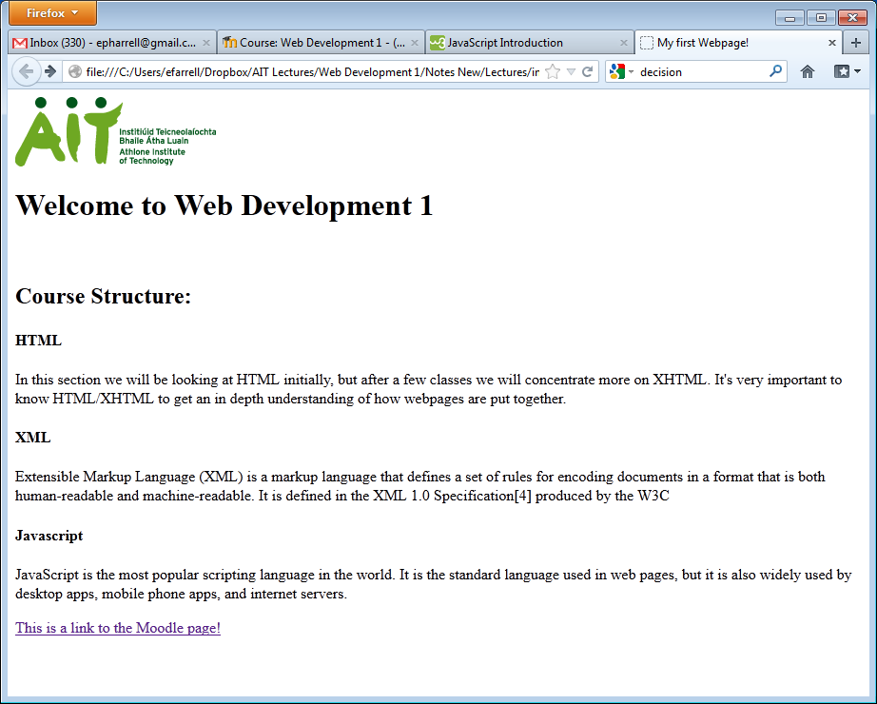

Slide 20
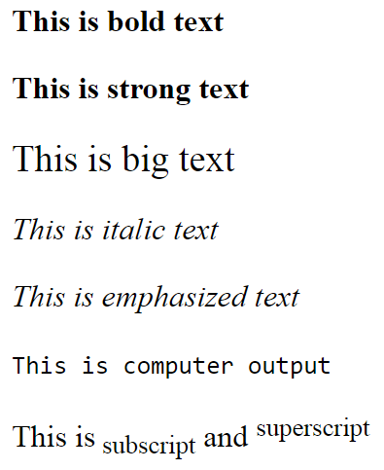
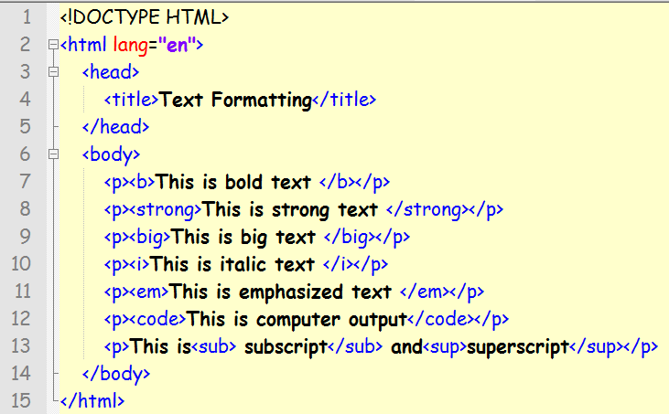
HTML Text Formatting

